Slide 1

Using Adobe Connect a Virtual Meeting Room
Kelvin Cheng
ITS - User Services Team
Ver 1.1

Slide 2
Agenda
What is Adobe Connect
Creating a meeting
Select Participants
Inviting People to Your Meeting
Meeting roles and interface
Managing Participants
Managing Layouts & Pods
Managing Meetings
Content Library
Managing Content
Supported File Type

Slide 3
Agenda
Sharing contents
Install Connect Add-in
Presenting Basic Content
Sharing Content Screens and Applications
Polling, Chatting & Notes
Ending or Exiting a meeting
Advanced features
Breakout Sessions
Recording a Presentation
Using Adobe Connect Mobile App
Viewing Data Dashboard
Keyboard shortcuts
Booking virtual room - iBooking

Slide 4
What is Adobe Connect
A web conferencing solution for web meetings, eLearning, and webinars.
Delivers rich interactions
Entirely Adobe Flash based.
All meeting rooms are organized into ‘pods’
Each pod performing a specific role (i.e. chat, whiteboard, note, etc.).

Slide 5
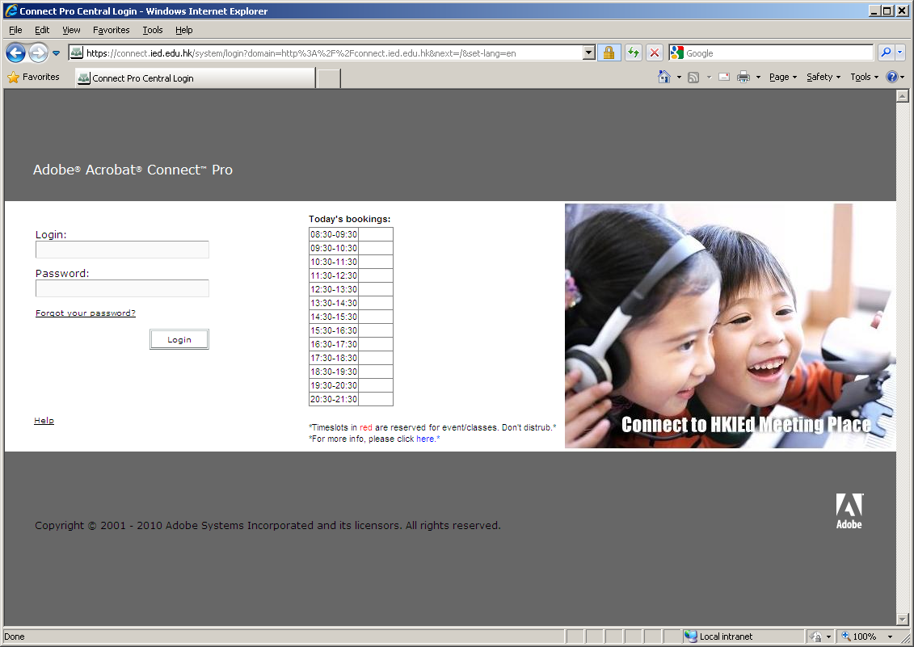
Access to Adobe Connect
http://connect.ied.edu.hk

Slide 6
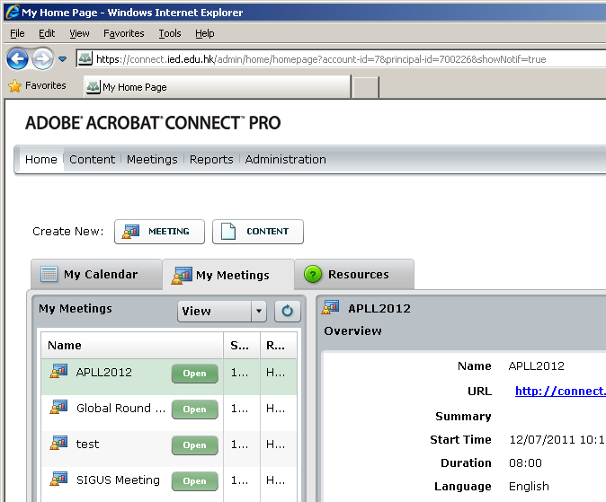
Access to Adobe Connect
Home tab
Home
Content
Meetings
Reports
Administration

Slide 7
Creating a meeting
Enter Meeting Information
Name, URL, date/time, access
Select Participants
Roles and Permission
Send Invitations
With Outlook Calendar event (iCal)

Slide 8
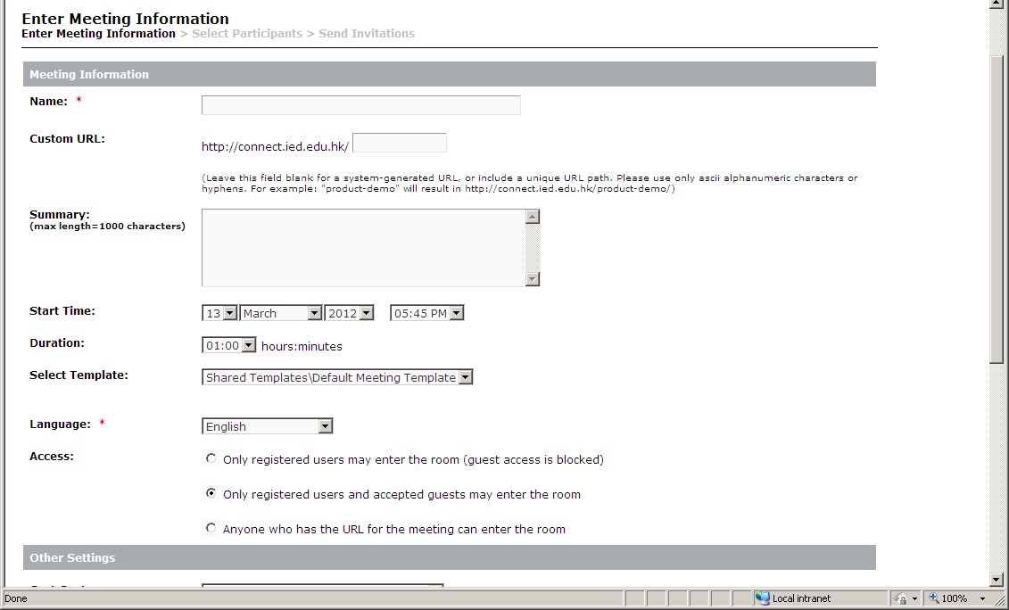
Enter Meeting Information

Slide 9
Enter Meeting Information
Meeting Name and Language fields are required.
Recommended to enter a short name in the Custom URL field rather than having a random string generated by the server.
Set the Access as appropriate.
Only registered users may enter the room (guest access is blocked)
An individual must authenticate with a HKIEd staff account.
The individual must appear in the meeting's list of Current Participants (set in a later step).
Only registered users and accepted guests may enter the room
Users listed in the meeting's Current Participants can enter the meeting after authenticating.
Anyone with the link to the meeting can Enter as a Guest, but must also be approved by a designated Meeting Host before the meeting window will open.
Allows the Meeting Hosts to effectively screen the attendees and avoids the need for all attendees to have an Adobe Connect account.
Anyone who has the URL for the meeting can enter the room
No authentication or approval is needed to join the meeting.
Assumes that anyone with the link to the meeting is allowed.

Slide 10
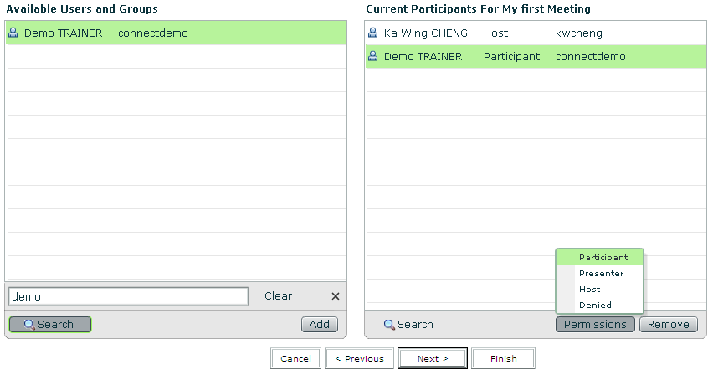
Select Participants

Slide 11
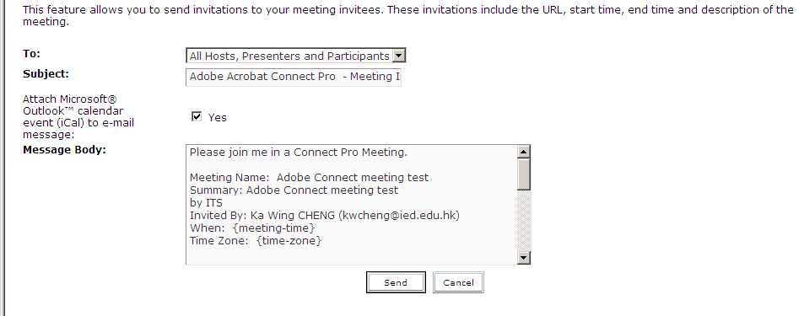
Send Invitations

Slide 12
Meeting Roles and Permissions
Determines an attendee's capabilities for sharing, broadcasting, and other activities
3 roles for meeting room attendees:
Host
Presenter
Participant
The creator/owner of a meeting is designated as a Host by default.
Creator can specify each attendee's role, including selecting other attendees to act as permanent Hosts for the meeting.

Slide 13
Meeting Roles and Permissions
Host
Can add/edit layouts in a meeting room.
Can promote other participants to Host or Presenter
Give enhanced permissions to a Participant without promoting the participant.
Create and manage small group breakout rooms within a meeting.
Perform all the tasks that a Presenter or Participant can.

Slide 14
Meeting Roles and Permissions
Presenters
Can share content already loaded into the meeting room from the library and share content from their computer, including Adobe Presenter presentations (PPT files), Flash application files (SWF files), images (JPEG files), and FLV files.
Can share their screen with all attendees, chat, and broadcast live audio and video.

Slide 15
Meeting Roles and Permissions
Participants
Can view the content that the presenter is sharing, hear and see the Presenter's audio and video broadcast, and use text chat.

Slide 16
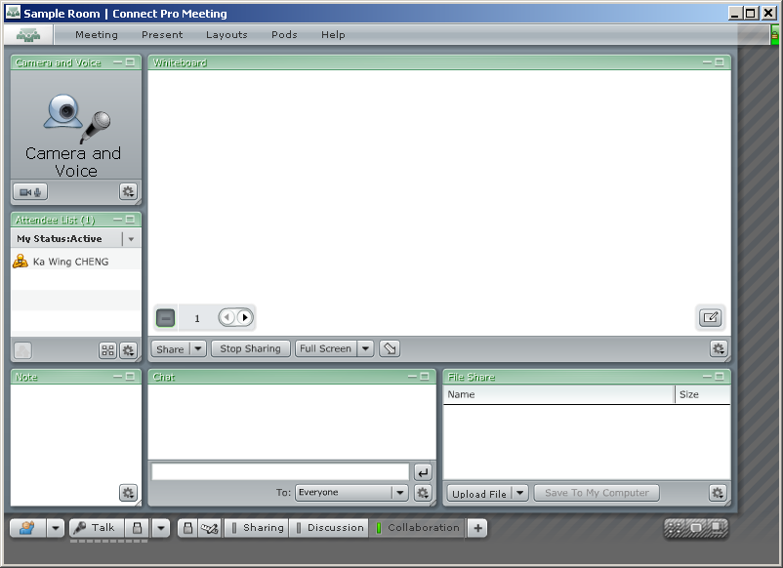
Managing Layouts & Pods

Slide 17
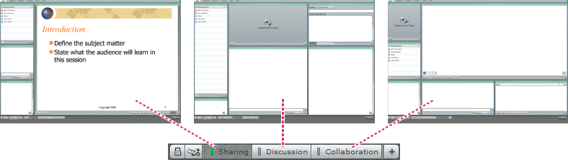
Layouts
3 preset layouts
Sharing
Discussion
Collaboration
When a Host configures the layout of a meeting room, the Host determines the number, type, size, and position of the pods that participants see.

Slide 18
Pods
Pods - are the means by which activity takes place during a meeting.
Share pods
Display shared content from the presenter's computer (including windows, applications, or the entire desktop), documents, or whiteboards.
Multiple Share pods can be created within a single meeting.
Note pod
Comes in different types, but each displays text messages from Hosts or Presenters to all attendees.
Attendee List pod
Displays the name, role, and status of each attendee.
Host can manipulate an attendee's role, permissions or status.
Chat pod
Allows attendees to send chat messages to other attendees.

Slide 19
Pods
Camera And Voice pod
Allows Hosts, Presenters, and Participants with appropriate permissions to broadcast video to all attendees.
Files/File Share pod
Allows Hosts and Presenters to post files which can be downloaded by attendees.
Multiple File Share pods can be created within a single meeting.
Web Links pod
Similar to the File Share pod, but allows links to be posted rather than files.
Poll pod
Allows Hosts and Presenters to conduct polls or ask questions of attendees.
Q & A pod
Similar to Chat pod, but comments and questions are redirected to the Presenters and only posted to the attendees when the Presenters provide an answer.

Slide 20
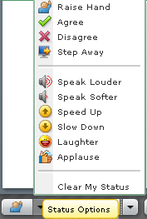
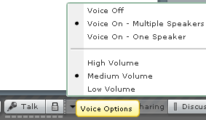
Managing Meetings
Status Options
Raise Hand
Agree
Disagree
Step Away
Speak Louder
Speak Softer
Speed Up
Slow Down
Laughter
Applause
Voice Options
Voice On/Off
Volume

Slide 21

Managing Meetings
Turn Off Move and Resize Pods
Turn On Preparing Mode
Allows host to go behind the scenes and add or change layouts.
Show Invitee List
Show Presenter Only Area
A hidden area from the view of participants. And let you to keep certain pods open and to collaborate with other hosts and presenters while a meeting is on-going.

Slide 22
Content Library
The Content library holds content that you use in meeting rooms and virtual classrooms.
Content includes presentations, SWF files, image files, audio files, video files, and so on.

Slide 23
Supported File Type
All content in the Content library must be one of the following types:
A single PDF file
A single PPT file
A single SWF file
A single HTML file
A single Adobe Captivate SWF file
Adobe Captivate content published through the Adobe Captivate application
Adobe Presenter content published through the Presenter plug-in
Presenter content packaged as a ZIP file
An old Macromedia Breeze 4.1 presentation packaged as a ZIP file (downloaded for a 4.1 server) (Breeze is now Adobe Acrobat Connect Pro.)
A ZIP file that contains multiple SWF files and extra files (images, XML files, and so on) and a file called index.swf that is loaded first
A ZIP file that contains simple Authorware® content (one HTM file, one AAM file, and extra Authorware files)
A ZIP file that contains multiple HTM or HTML files and extra files (images, SWF files, and so on) and one file called index.htm or index.html
A ZIP file that contains a single PDF file.
An FLV file
A single image (JPEG, GIF, or PNG)
A single audio file (mp3)

Slide 24
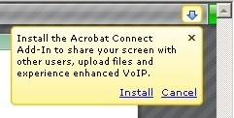
Installing Connect Add-in
Allows Hosts and Presenters to share their screen, control other users' screens, and upload their files to meetings.
Available for Windows and Macintosh operating systems.
https://connect.ied.edu.hk/common/help/en/support/downloads.htm

Slide 25
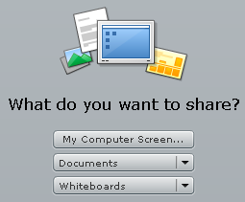
Sharing Contents
Sharing content in the Share pod
Share your screen
Desktop
Application
Window
Share a presentation
Share a document
From your computer
From Content Library
Share a whiteboard
Upload and manage files using the File Share pod
From your computer
From Content Library

Slide 26
Polling, Chatting and Notes
Polling attendees
Use the Poll pod to create questions, or polls, for participants and to view the results.
Only hosts can control poll management and how polls appear to meeting participants. Hosts can also cast votes.
Useful during a meeting if you want instant feedback on what is being presented.
Can also be used at the end of a meeting to find out if participants felt the meeting, content, and presenters were high-quality.

Slide 27
Polling, Chatting and Notes
Chat in meetings
Communicate with other attendees while a meeting is in progress.
Presenter can use more than one Chat pod simultaneously. Chat pods can be set to display content to everyone or to presenters (and hosts) only.
Messages appear as they are submitted, and are listed sequentially.
Presenters can allow participants to conduct private chats, to clear a chat, and to turn off chat notifications.
Chat pod content is persistent, and remains in a meeting room until deleted. If you want to preserve Chat pod content for future use, you can e‑mail the content.
Q & A pod
To answer questions posed by attendees.
Linked to the Chat pod. When an attendee asks a question in the Chat pod, a presenter can answer in the linked Q & A pod. When a presenter answers a question, the question and answer appear as pairs in the Chat pod.

Slide 28
Polling, Chatting and Notes
Taking notes in a meeting
Hosts and presenters use a Note pod to take meeting notes that all attendees can see. It remains visible in a Note pod throughout the meeting or until a presenter edits the note or displays a different note.
Host can remove the Note pod from view, or switch to a different room layout that does not contain that Note pod.
Can use the Note pod in several ways:
Create a single, persistent note that is visible to attendees.
Create multiple notes in a single pod.
Create multiple Note pods to display different notes.
You can also e‑mail the contents of a note pod.

Slide 29
Ending or Exiting
End Meeting
By selecting Meeting -> End Meeting…
Allow you to customize a closing message for the attendees and direct them to another URL for further information.
Exit Connect Pro
By selecting Meeting -> Exit Connect Pro or
By simply closing the meeting room window
The meeting stays open for other attendees, who can continue to collaborate for 10 minutes.
After 10 minutes, they are notified that the meeting room will close in 1 minute.

Slide 30
Breakout Sessions
Create sub-rooms that can be created within a meeting session.
Useful for splitting a large group into smaller groups that can talk or collaborate.
Can create up to 5 breakout rooms for a single meeting session.
For example,
If you have 20 people in a session, you could create 4 breakout rooms and move 5 attendees to each room.
The attendees can speak to each other, use the Chat pod, collaborate on a whiteboard, and share their screens.
The host can visit all of the breakout rooms to assist and answer questions.
When complete, the host can end the breakout session and return attendees to the main room.
Hosts are able to share what happened in the breakout rooms with everyone. If necessary, the host can return attendees to their same breakout rooms. If you use the room again, you can also reuse the breakout room layout and content. (However, the assignment of attendees to breakout rooms is not retained.)

Slide 31
Recording a Presentation
Host can record a meeting session. When played back, the recording shows exactly what the attendees saw and heard.
Everything that happens in the room is recorded, except for the Presenter Only area and breakout rooms.
You can start and stop recording at any time, so you decide what content to record.
When you record a meeting, consider the following:
If you use the Camera And Voice pod to broadcast audio to meeting attendees, all audio is recorded automatically.
The meeting recording is assigned a URL and added to the Recordings page associated with the meeting room in Acrobat Connect Pro Central. To play a recording, you need an Internet connection, the recording URL, and permission to view it.

Slide 32
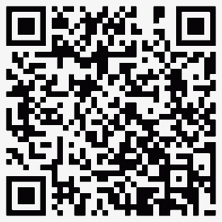
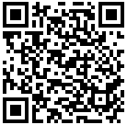
Adobe Connect Mobile
iOS devices
iPhone:
http://itunes.apple.com/hk/app/adobe-connect-mobile-for-ios/id430437503?mt=8
iPad:
http://itunes.apple.com/hk/app/adobe-connect-mobile-for-ios/id430437503?mt=8
Android devices
https://play.google.com/store/apps/details?id=air.com.adobe.connectpro
Blackberry Playbook
http://appworld.blackberry.com/webstore/content/36989/?lang=en

Slide 33
Viewing Data Dashboard
Provides graphical representation of statistical data about your meetings.
From the Home Tab click Meetings, then click Meeting Dashboard.
Reflects all the meetings you have created, appears in three bar graphs; clicking in any of the bar graphs brings up the Summary Report for the meeting.
Type of bar charts
Most Active Meetings Over Last 30 days
Determined by the no. of sessions.
Most Participant Meetings Over Last 30 Days
Determined by the no. of participants.
Counts only registered attendees; guest attendees are not included in the count. However, guest attendees are included in the data reported in the Summary Report for each meeting.
Most Viewed Recordings Over Last 30 days
Determined by the number of views (that is, the number of times each archived meeting has been viewed).

Slide 34
Keyboard Shortcuts
Result | Windows | Macintosh
Toggles Microphone on (locked) or off. | Ctrl+M | Control+M
Toggles Raise-Hand status. | Ctrl+Up Arrow | Control+Up Arrow
Toggles Full Screen mode. Applies to the currently selected Share pod. | Ctrl+. | Control+.
Promote to host. Requires selected item(s) in Attendee List. | Ctrl+' | Control+'
Demote to participant. Requires selected user in Attendee List. | Ctrl+] | Control+]
Promote to Presenter. Requires selected user in Attendee List. | Ctrl+/ | Control+/
Start/Stop Recording. For Start, brings up the Start Recording Dialog. | Ctrl+, | Control+,
End meeting. Brings up the End Meeting Dialog. | Ctrl+\ | Control+\
Start/Stop Desktop Sharing. Applies to currently focused Share pod. | Ctrl+[ | Control+[
Bring up first application bar Menu for keyboard navigation. | Ctrl+Space | Control+Space
Toggles Play/Pause during playback of recorded meetings. | P | P

Slide 35
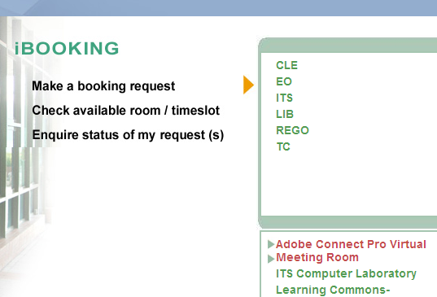
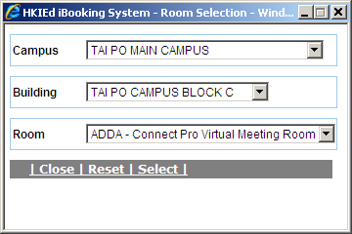
Booking virtual room-iBooking
Make booking from iBooking system
Bookings are made under an honest system, we need our colleagues to book the meeting in advance.
50 concurrent users.

Slide 36
References
ITS Adobe Connect Pro Meeting Room - http://www.ied.edu.hk/its/services/adobe_connect.htm
Adobe Connect - http://www.adobe.com/products/adobeconnect.html
Adobe TV (Adobe Connect) -http://tv.adobe.com/product/connect-8
Adobe Connect User Community - http://www.connectusers.com/

